Slide 1

watsonx.ai
Synthetic data generator
—
Tom Gaffney Synthetic Data on watsonx.ai, Product manager thomas.gaffney@ibm.com Anshupriya Srivastava Advisory, Learning Content Development, Data & AI Anshupriya.Srivastava@ibm.com
Notes:
This presentation shares insights into IBM’s approach to synthetic data and how IBM leverages alternative models to generate data enterprise applications. Synthetic data is artificially generated data often used in situations where real data is either unavailable, insufficient, or sensitive. Real data, is information that is collected from real-world events and processes,

Slide 2

watsonx
The platform for AI and data
watsonx.ai
Train, validate, tune, and deploy AI models
watsonx.data
Scale AI workloads, for all your data, anywhere
watsonx.governance
Responsible, transparent, explainable AI workflows
A next generation enterprise studio for AI builders to train, validate, tune, and deploy both traditional machine learning and new generative AI capabilities powered by foundation models. It enables you to build AI applications in a fraction of the time with a fraction of the data.
Fit-for-purpose data store, built on an open lakehouse architecture, supported by querying, governance and open data formats to access and share data.
End-to-end toolkit for AI governance across the entire model lifecycle to enable responsible, transparent, and explainable AI workflows.
Today’s focus
Notes:
Watsonx, the new IBM platform for AI and data is designed with the three most critical elements of an AI strategy in mind: data, governance, and an AI workspace. It empowers enterprises to train, tune, and deploy AI across the business, leveraging critical, trusted data wherever it resides.
This platform has three components:
watsonx.ai - A studio that clients can use to train, validate, tune, and deploy both machine learning (ML) AI models as well as foundation models (FM) for generative AI. This platform combines best-of-breed architectures with a rigorous focus on data acquisition, provenance, and quality, to serve enterprise needs.
watsonx.data - Makes it possible for enterprises to scale AI workloads using all their data with a fit-for-purpose next generation (multicloud and multi-engine) data lakehouse service optimized for governed data and AI workloads, supported by querying, governance, and open data formats to access and share data. Watsonx.data is based on open-source technologies, including Presto, Iceberg, Spark, and more.
watsonx.governance - Helps companies put AI into production by providing an end-to-end solution that encompasses both data and AI governance to enable responsible, transparent, and explainable AI workflows. AI governance helps business analysts understand the trustworthiness of their AI solutions.

Slide 3
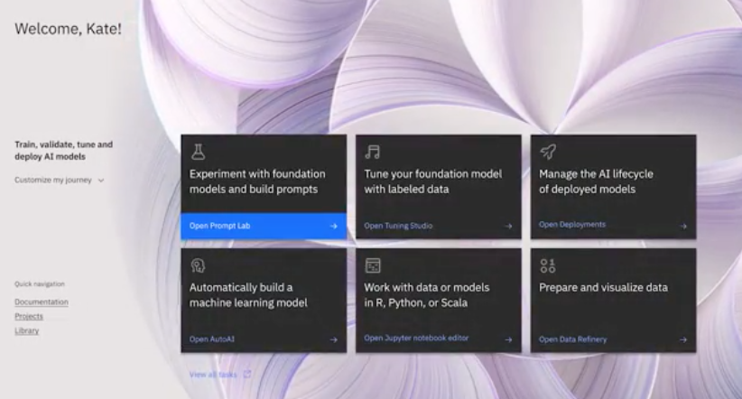
watsonx.ai
Train, validate, tune and deploy AI models
A next generation enterprise studio for AI builders to build, train, validate, tune and deploy generative AI, foundation models, and machine learning capabilities
Foundation Model Library with IBM and open-source models
Prompt Lab to experiment with foundation models and build prompts for various use cases and tasks
Tuning Studio to tune your foundation models with labeled data
Data Science and MLOps to build machine learning models automatically with model training, development and visual modeling, and synthetic data generation
Today’s focus
Notes:
IBM watsonx.ai is our enterprise-ready next-generation studio for AI builders, bringing together traditional machine learning (ML) and new generative AI capabilities powered by foundation models. With watsonx.ai, businesses can effectively train, validate, tune, and deploy AI models with confidence and at scale across their enterprise.
There are four main components of watsonx.ai –
Foundation models: Clients have access to IBM-selected open-source models from Hugging Face as well as a family of IBM-trained foundation models of different sizes and architectures, starting with Slate, specifically used for non-generative AI tasks such as extraction and classification.
Prompt Lab: Where AI builders can work with foundation models and build prompts using prompt engineering. Within the Prompt Lab, users can experiment with zero-shot, one-shot, or few-shot prompting to support a range of Natural Language Processing (NLP) type tasks including question answering, content generation and summarization, text classification, and extraction.
Tuning Studio* (coming soon): Subsequent watsonx.ai releases will include capabilities for prompt tuning and fine-tuning foundation models as part of our Tuning Studio to help tune your foundation models with labeled data for better performance and accuracy, without changing the underlying weights of the foundation model.
Data Science and MLOps: Build machine learning models either visually or with code automatically, with end-to-end lifecycle explainability and fairness. Use MLOps to simplify model production from any tool and provide automatic model retraining. You can even address any data gap by creating synthetic tabular data.

Slide 4
“Real data provides real challenges regarding privacy, security, process, and regulation which…stifles our ability to innovate” - Telecommunication company “We developed over 200 models and deployed only 4” - Financial technology company
Notes:
IBM has engaged with professionals from finance, telecommunications, insurance, health, automotive, marketing, and communications. A common issue IBM has found out is that the AI journey needs more data. It's crucial for clients to understand the importance of synthetic data and how it addresses real data gaps across various industries.
These data gaps have become an innovation challenge, hindering companies from keeping up in the dynamically changing market in which AI can help their business. This bottleneck leads to slow progress and low model deployment rates, as can be seen by the real client quotes on this slide. For example, a fintech firm could only deploy 2% (4/200 = 2/100 = 2%) of all models they developed and a telecommunication company notes that the use of real data with their AI journey created availability issues too. Data privacy and security are a genuine challenge for businesses.
Notes:
1. Data gap: Data gap refers to a missing or incomplete set of data within a dataset or information that is not available but is needed for a specific analysis, task, or decision-making process. It represents a portion of data that is absent, either because it was not collected, not recorded, or not available for some other reason.

Slide 5
The problem Real data = risk, costs, & delays
Costs²
59%
of AI budgets on average are spent on training data.
Heavy penalties¹
$2.3bn
in cumulative GDPR fines since 2017, with 50% attributable to non-compliance with general data processing principles.
Transformation delays
4-6weeks +
for teams to get access to production data, setting back project timelines & delaying progress. This can extend to months for certain industries and data types, like financial institutions and healthcare.
Notes:
As this self-explanatory slide illustrates, using real data to address data gaps exposes businesses to additional risks, including financial penalties. For example, privacy concerns have led to hefty costs, discouraging companies from collecting new data.
There have been 2.3 billion worth of penalties since 2017 related to the General Data Protection Regulation (GDPR) and privacy. On average, companies are spending 59% of their AI budget on gathering training data and the delays in accessing real data have frustrated lines of businesses, with some waiting for weeks or even months for access to data with their Enterprise to even start their AI journey.
But where there are challenges, there are also opportunities for IBM to solve these issues creating solutions for clients.
Sources:
1. https://www.eqs.com/compliance-blog/biggest-gdpr-fines/ 2. https://www.lxt.ai/path-ai-maturity/

Slide 6

The solution Real data + synthetic data
Benefits
5
advantages of leveraging synthetic data:
Innovation/GTM speed
Minimal risk
Reduced costs
Scale
Sharing & monetization
Synthetic adoption¹
60%
of all data used for the development of AI and analytics projects will be synthetically generated, by 2024
Notes:
Synthetic data is the solution to circumvent the issues detailed so far in the presentation because it offers clients a quicker, cost-effective, and less risky alternative to close the data gap. Synthetic data offers several benefits, including faster innovation and go-to-market speed, reduced privacy risk, reduced costs, scalability, and data sharing and monetization capabilities. Specifically:
Innovation Speed: In terms of faster innovation and go-to-market speed, companies no longer need to wait for data. Companies can generate their own data, quickly.
Risk Reduction: Since the generated data is synthetic, companies can also reduce privacy risks. IBM has added an additional mechanism to watsonx.ai’s synthetic data generation process to help clients get more insights and control over how much privacy protection to guarantee with every synthetic data generation job run at a reduced cost.
Cost Reduction: Companies can reduce costs by spending less time collecting data or spending on financial penalties.
Scale: Clients can shift focus on data that is needed for scale, because they can generate as much synthetic data as they need for a particular use case.
Sharing and Monetization: Data is valuable but protected and sensitive. Data that couldn't be accessed, can now potentially be shared and monetized if it is synthetic. This can open up new revenue streams for companies.
Because of these advantages, IBM anticipates a significant surge in synthetic data adoption over the next few years, with various sources such as Gartner predicting its widespread use. Companies are adopting synthetic data to overcome real data challenges and increase their operational efficiency.
IBM watsonx.ai’s synthetic data capability will help companies move at a faster pace in their AI journey and overcome data-related hurdles.
Source:
1. Forbes, “Synthetic Data Is About To Transform Artificial Intelligence”, 2022.

Slide 7




There are two types of synthetic data
Unstructured synthetic data PoC/``
Structured synthetic data PoC/purchase = Q2’23
Data not arranged according to a preset
data model or schema,
and therefore, cannot be stored in a traditional relational database
Examples are text, images,
and videos
watsonx.ai
Large Language
foundation models to generate synthetic text (images and video
not supported)
Data that has a standardized format, typically tabular with rows and columns that clearly define data attributes
Examples are Excel files or
data in relational databases
watsonx.ai
Synthetic Data
Generator
Notes:
There are two types of synthetic data - Unstructured and Structured:
Unstructured: Data that cannot be stored in traditional databases. For example – text, images, videos, and so on
Structured: Structured data has a standardized format and is clearly defined. This is data that often has a schema (defined and enforced rules) with rows and columns with labels; examples include – Excel files, data in relational databases, and so on.
With watsonx.ai, clients are able to tackle unstructured synthetic data (specifically text) by leveraging large language models. Using watsonx.ai synthetic data generator clients can tackle tabular synthetic data use cases.

Slide 8







Common use cases for synthetic tabular data
Client demo data
Creating synthetic data to tailor demos for particular clients/industries, before real client
data becomes available
Employee training assets
Generate data needed to improve the realism of internal training programs
AI model
training
Generating more data or edge case data to combine with real data to improve predictive accuracy
of AI models
Monetize/share
externally
Generating more data or edge case data to combine with real data to improve predictive accuracy
of AI model
Extract
insights
Create 1-for-1 synthetic copy of sensitive data,
to share internally for insight extraction and strategic analysis
Application
test data
High-fidelity, synthetic test data to expedite test cases and validation of software functionality, performance, and reliability
What-if
assessments
Simulate how synthetic agents’ individual decisions impact macro-level metrics, like fraud, sales, or patient diagnoses
Notes:
As detailed in this self-explanatory slide, IBM has identified 7 common use cases for synthetic tabular data across companies and industries:
Demo data – Generate data using synthetic data generator to create more realistic client-facing demos.
AI model training – Clients can generate synthetic data for edge cases or create more sample data from a small sample set to train AI models better.
Employee Training data – Synthetic data can be used to generate realistic scenarios to improve the quality of training that clients give internally to their employees.
Monetize/share – Clients can share synthetically generated data and share it externally with business partners for enhanced alignment and coordination which can result in better results. This high-quality dataset can also be monetized with little concern for privacy since it is very valuable to individuals and other companies.
Extract insights – Different teams within the organization can use this synthetic data to derive insights to develop corporate strategy.
What-if assessments – Clients can create what-if scenarios using synthetic data. This data can be used in simulations, layered with business rules, and then assessed for various KPIs.
Synthetic test data – Clients need high-fidelity, multi-table synthesis to evaluate software functionality, performance, and reliability.
Notes:
KPI: Key performance indicators evaluate the success of an organization or of a particular activity in which it engages.

Slide 9
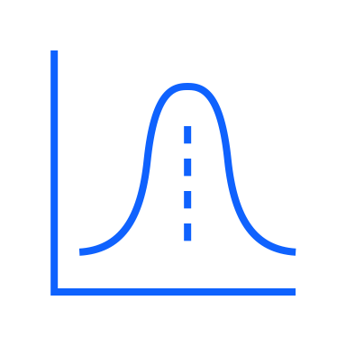
Two model types to generate tabular synthetic data
Statistical
Generative-AI
The benefits
The benefits
Control
Automated
High-fidelity
Cost efficient
User friendly
Speed
Privacy
Privacy
Automated
Custom schema
The shortcomings
The shortcomings
Approximates
Higher cost & longer runtimes
Stats knowledge
Less flexibility
Notes:
Watsonx.ai’s synthetic data capabilities include a variety of models to tackle the use cases (Client demo data, AI model training, Employee training data, Monetize/share externally, Extract Insights, what-if assessments, and Application test data) detailed in the previous slide. Specifically:
Statistics-based model – The statistics-based model is quick and affordable. This model can be used without worrying about complex infrastructure, and it also gives clients more control over whether they want to change the original data structure. However, clients need to understand the data distributions if they want to make changes. It is better oriented for data scientists and data experts than the line of businesses due to the need to understand data distributions. This model works well when extremely precise results are not required. For example, statistics-based models can be used for building demo data.
Generative AI-based model – Generative AI-based models require low upfront effort. This model can create highly detailed results, which is great for capturing complex patterns in data. This makes this model more line-of-business friendly. The trade-off is a relatively longer run-time, but still quick. Also, it requires GPU over CPU which makes it more expensive. Generative AI-based models can be used to develop training and testing data during the model development process.

Slide 10
Guidance on which model can enable client use cases
Use cases ¹
Schema
Data types ²
1. Demo data
3. AI model training
Special types
2. Training data
4. Monetize/share
5 Extract insights
7. Test data
Custom
Categorical
Continuous
6. What-if
Existing data
Time-series
Statistics-based
Generative AI
Good fit
Limited
Not a good fit
Notes:
This self-explanatory slide provides guidance on which model can enable client use cases.
Use cases
As discussed earlier, the same synthetic data generation model is not appropriate for all of the previously detailed synthetic data use cases. This self-explanatory slide shows a cheat sheet that maps which synthetic generator model would be better positioned depending on the use case. For example, the statistics-based model would be good in scenarios where the requirement is to generate demo data, AI model training data, and employee training data. Clients can use the statistics-based model to try and generate edge cases with demo data if it does not need high fidelity.
Since the Generative AI-based model provides higher fidelity, it can be used for monetization, insight extraction, and test data creation along with the other use cases mentioned above.
Schemas
All of these synthetic generator models can ingest existing data. Businesses have often expressed interest in creating custom data schemas. Statistics-based models would be the best option for this use case.
Data types
These models support categorical and continuous data types as of now. IBM plans to support time series and other special data types in the future.
Notes:
Roadmap item: Test data/multi-table and time-series data synthesis planned for Q2/Q3’24
Roadmap item: Special data types are synthetic social security numbers, product codes, account numbers, correlated city/state/zip codes, etc..

Slide 11





Privacy protection when leveraging sensitive data
What is differential privacy?
Identifies rare individuals in datasets and adds “noise” to obscure their individually specific information
What are its benefits?
Can’t identify data specific to an individual
Protection against 3rd party attackers
Computational
transparency
Privacy bounds
guarantee
.
Notes:
The question that arises is, “Even though the data is synthetic, it is still generated by leveraging existing data. There must be some risk in that, right?”
IBM mitigates this risk by leveraging differential privacy. Differential privacy ensures that data analysis and sharing can be performed while minimizing the risk of disclosing sensitive information. Differential privacy gives users control over the amount of privacy they need in their generated output. With differential privacy, users have the flexibility to determine how much privacy they want in the results. They can specify the level of data anonymization or protection to suit their needs. Guarantees are provided on the amount of privacy users are afforded.
Unlike traditional data randomization methods, differential privacy offers computational transparency which means that users can understand how privacy measures are applied. This ensures that data protection is in place without compromising the quality of the results.
This privacy mechanism also identifies rare individuals in the dataset that could be identified by third-party attackers. It prevents attackers from identifying specific individuals within the data, ensuring that no personally identifiable information (PII) can be traced in the synthetic generator output. Differential privacy uses mathematical noise to preserve individuals’ privacy and confidentiality while allowing population statistics to be observed. This noise makes it exceedingly challenging for third parties to distinguish or identify specific individuals, even in datasets with minimal representation.
Example: A bank building a model to assess the creditworthiness of its customers without compromising their privacy. To do so the bank needs to have access to various financial attributes of their customers, such as income, credit history, and outstanding debts. In a traditional approach, the bank could build a credit scoring model using the exact financial data of its customers (including some sensitive information). If an attacker gains access to this model or its outputs, they could potentially reverse-engineer the data and identify specific individuals. If the bank decides to apply differential privacy to its credit scoring model, instead of using precise financial data, it injects random or scrambled information (controlled noise) into the data used for model training and decision-making. When a loan application is submitted, the bank's system evaluates the applicant's creditworthiness using the privacy-preserving model. The results, such as a credit score or loan approval decision, are also perturbed with noise.
The noise ensures that even if an attacker gains access to the model or its outputs, they cannot confidently determine the exact financial details of an individual applicant.
Source:
“Differential Privacy: A Primer for a Non-technical Audience”, Harvard University, 2018
Rare Individuals: A rare individual is a data point with unusual characteristics, behaviors, or attributes that make them stand out from the rest of the individuals in the dataset.

Slide 12

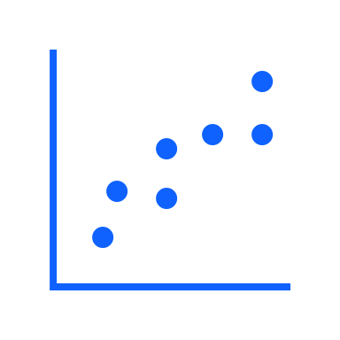

Assessing the quality of the synthetic output
Fidelity
Measures the quality of the synthetic data in terms of its closeness in distribution & correlations to the real data
Privacy
Assesses leakage of real data in synthetic output, as well as membership inference attacks, such as nearest neighbor
Utility
Measures the accuracy and performance of a predictive downstream task where predictive models are trained on the synthetic data
Fairness
Assesses bias in the synthetic data and the fairness of the predictions with respect to sensitive and protected communities
Roadmap item
Notes:
IBM provides certain metrics to assess the quality of the output generated by watsonx.ai’s synthetic data tool, specifically:
Fidelity: Fidelity measures the quality of the synthetic data by assessing its closeness in distribution to the real data. This dimension is essential to ensure that synthetic data accurately represents the statistical properties of the original dataset. Example: While developing a fraud detection model a bank may need synthetic transaction data. This synthetic dataset may include elements like transaction amounts and dates, however no real customer data, for privacy reasons. Fidelity here means the generated synthetic data closely mimics real transaction patterns, such as spending habits and transaction frequencies. If the real data shows certain spending trends, the high-fidelity synthetic data would mirror these trends. This would allow the bank to train and refine its algorithm effectively while ensuring customer privacy.
Fairness¹: Fairness evaluation in synthetic data is crucial in preventing bias and promoting fairness in predictive models. It assesses the presence of bias in the synthetic data and checks the fairness of predictions concerning sensitive and protected communities. Example: A bank creating synthetic data to train a credit scoring model. Fairness in this synthetic data means ensuring it doesn't contain biases against specific groups like ethnic minorities or certain age groups. If real data shows historical biases, like certain groups having less access to credit, these should not be replicated in the synthetic data. Fairness evaluation checks will help in adjusting this data to represent all groups equitably, preventing the credit scoring model from perpetuating existing disparities and ensuring fair treatment of all loan applicants.
Utility: Utility measures the effectiveness of synthetic data in supporting predictive downstream tasks. It assesses the accuracy and performance of predictive models trained on the synthetic data, ensuring it maintains the data's usefulness. Example: A bank using synthetic data to test investment strategies. The utility of this synthetic data is measured by how well it helps in accurately predicting market trends and investment outcomes. If the synthetic data enables the bank's models to make predictions that closely match what would happen in the real market, it has high utility, ensuring the bank can reliably use it for strategy development.
Privacy: Privacy assessment is critical to understanding the extent of real data leakage in the synthetic output. It also evaluates vulnerabilities to membership inference attacks, such as nearest neighbors (nearest neighbors refer to a technique where an attacker compares a synthetic data point to the nearest data points in the original dataset. If the synthetic data point is very close or similar to a real data point, the attacker may infer that it is a member of the original dataset.), which could potentially reveal sensitive information. Example: A bank using synthetic data to analyze customer spending habits. Privacy assessment is crucial to ensure that this synthetic data doesn't inadvertently reveal any real customer's personal information. The assessment checks if the data could be traced back to actual individuals, protecting against risks like identity theft or privacy breaches. This ensures the bank can analyze spending patterns without compromising customer confidentiality.
Notes:
To be released in 2024

Slide 13

Case study
AI model training Compare AI model predictive accuracy when trained on synthetic data vs real data
Challenge & approach
Understand the trustworthiness of using synthetic data, by comparing the predictive accuracy of an AI model trained on production data vs synthetic data:
Data set: Loan application, demographic & historical credit data; 300K rows, 122 columns
Create 3 different synthetic versions of the data set
For each synthetic data set, train a downstream neural network on a prediction task & compare predictive performance
Results
IBM’s generative-AI model performed similarly to real data and outperformed other models, with regard to compute time & predictive accuracy
ROC-AUC of Downstream Neural Network Predictions when Trained on Different Synthetic data sets
Compute time
~5 min | ~60 min | ~60 min
Notes:
In collaboration with an early client, IBM leveraged a generative AI model and incorporated a differential privacy setting to ensure the privacy of the data during training and analysis. This client trained an AI model on real data and three synthetic data variations, including one dataset built using watsonx.ai’s synthetic data generator, and two other datasets built using open-source solutions.
The output demonstrates the remarkable fidelity of the data generated by watsonx.ai to the real data; note how it outperforms other open-source models. IBM’s AI model's output closely mirrors the characteristics of the original data and surpasses the performance of other models provided by open-source platforms.
A slight drop in quality, approximately 2.3% to 3.3%, is attributed to the application of differential privacy. The slight decrease in accuracy is a trade-off for enhanced data privacy. It arises from the controlled noise added to the data as part of the differential privacy mechanism
Notes:
Neural network: A neural network is a method in artificial intelligence that teaches computers to process data in a way that is inspired by the human brain
Fidelity: Fidelity measures the quality of the synthetic data by assessing its closeness in distribution to the real data. This dimension is essential to ensure that synthetic data accurately represents the statistical properties of the original dataset.
ROC: ROC stands for Receiver Operating Characteristic. It is a tool that is widely used to evaluate the performance of a classification model. The ROC curve is created on a graph by plotting the true positive rate and false positive rate.
True Positive Rate: Percentage of actual positives that have been correctly identified by the model. For example, if there are 100 sick patients with a disease, and the model identifies 90 of them as having the disease, then the true positive rate is 90%.
False Positive Rate: Percentage of cases where a test incorrectly identifies a negative case. For example, if there are 100 healthy people and the test wrongly identifies 10 of them as sick, then the false positive rate is 10%.
AUC: AUC or Area Under the Curve, measures the entire two-dimensional area underneath the entire ROC curve. The value of AUC ranges from 0 to 1. A higher AUC value indicates that the model is doing a great job of distinguishing between the classes.

Slide 14
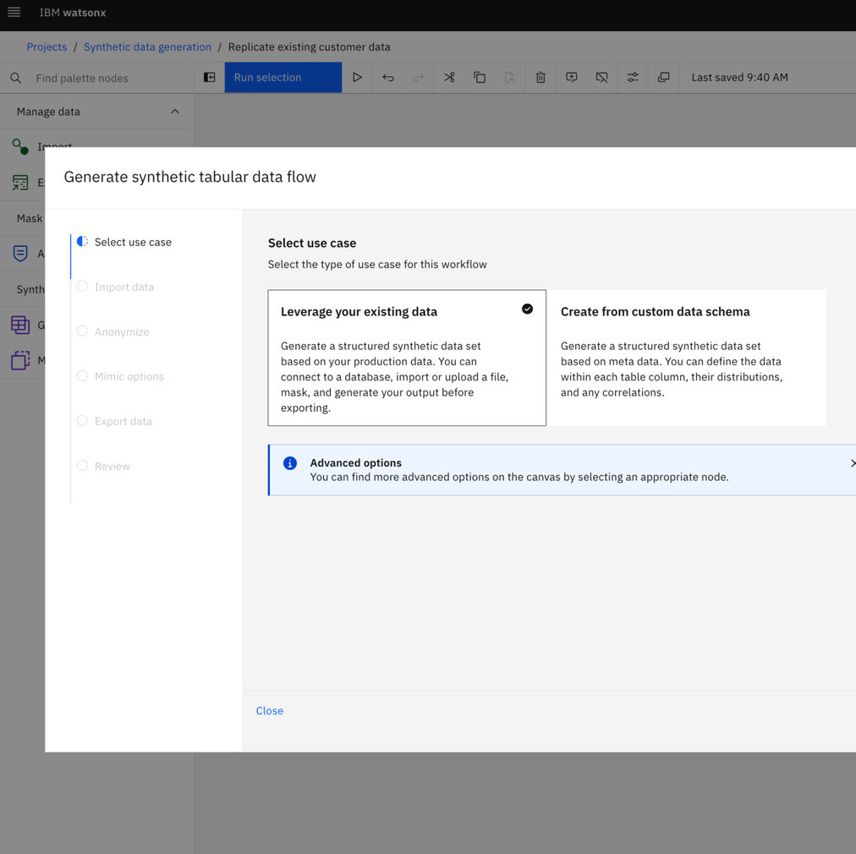
Let’s see a demo
14
Notes:
Details are self-explanatory. Use this slide if transitioning to a demo.

Slide 15



Opportunities to engage and learn more
Product
demo
Demo of existing synthetic capabilities & user experience
on watsonx.ai
Private preview of technology
Get access to new models (upcoming gen-AI models), for
early validation and testing prior
to their release
Early feedback and discovery
Be part of the early discovery process where you’ll provide IBM with input on upcoming features
to ensure they can tackle
your use cases
Proof-of-concept
(PoC)
Collaborate with IBM to validate the solution with a small use case
over a 6-week engagement
Notes:
This slide shows selling opportunities that can be leveraged to engage clients on watsonx.ai synthetic data generation capability.
Ways to engage:
The stats-based model is currently available on watsonx.ai and can assist with tasks like demo data, AI model training, and internal training data. Clients can start using it today to evaluate its suitability for their needs. Start a free trial here: https://dataplatform.cloud.ibm.com/registration/stepone?context=wx
IBM is delighted to offer a hands-on demo of the stats-based model. This allows gaining practical experience with this tool before making any commitments. Try it out at: https://www.ibm.com/account/reg/us-en/signup?formid=DEMO-dataaiwatsonxai
If the stats-based model aligns with a client’s objectives, clients can consider engaging in a Proof of Concept (POC) with IBM’s Client Engineering (CE) team. The IBM CE team is always ready to collaborate and tailor solutions to specific client needs: https://www.ibm.com/client-engineering
For models that are not yet released or generally available, IBM can provide early access to them. This opportunity, particularly for generative AI models, allows validating and testing these technologies ahead of their official release.
If the stats-based model or early access offerings don't align with requirements, IBM is open to continued discussions. Any feedback is invaluable in shaping IBM’s synthetic roadmap, and the aim is to ensure that clients are an integral part of this process.

Slide 16
Notes:
Thank you.

